Slide 1






TaxiCab Data Analysis
ROHIT MANRAL

Slide 2
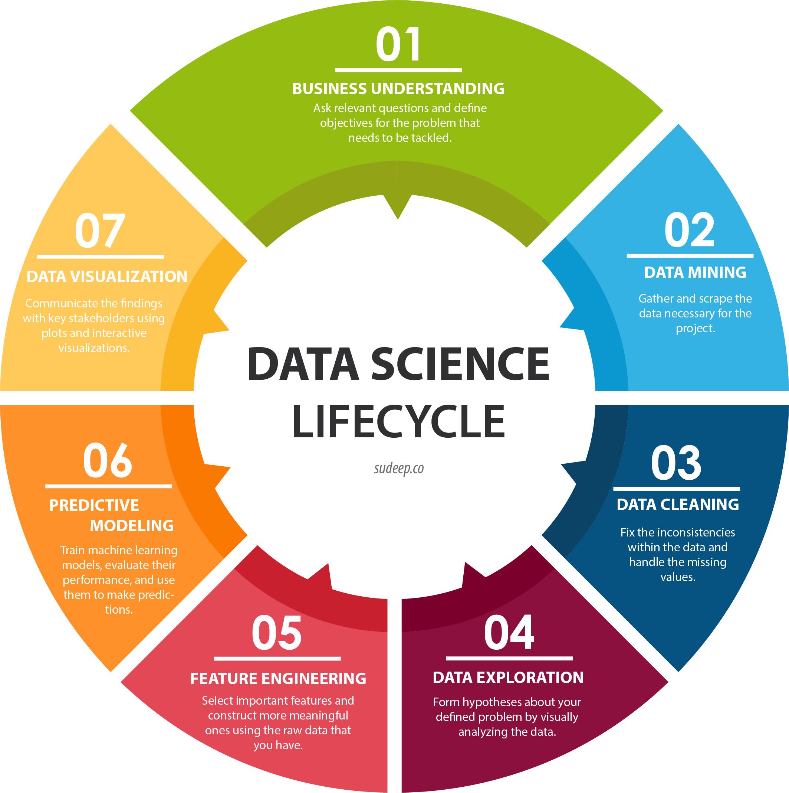
PROJECT CONTENT

Slide 3

01.
BUSINESS UNDERSTANDING
Average tip received by a vendor during the day
Which time of the day is the busiest?
Clean the Data and fix any anomalies
Classify trips based on Payment Type (not the number in the excel sheet but the actual payment type. Use metadata table for reference)
Is there any relationship between congestion surcharge and trip distance?

Slide 4
02.
DATA MINING
yellow_tripdata_2021-01_raw_updated.csv
surcharge_data.json

Slide 5
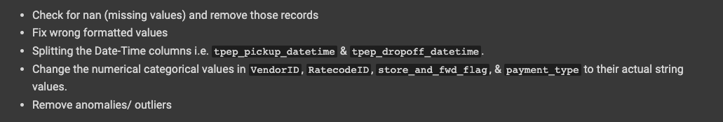
03.
DATA CLEANING

Slide 6
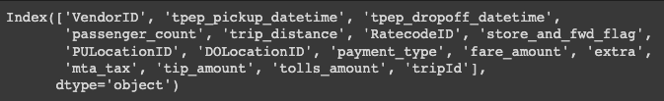
Data Description
yellow_tripdata_2021-01_raw_updated.csv
surcharge_data.json
Rows: 1369765
Columns: 16
Rows: 1369765
Columns: 3

Slide 7
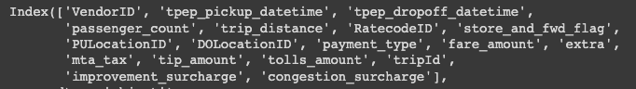
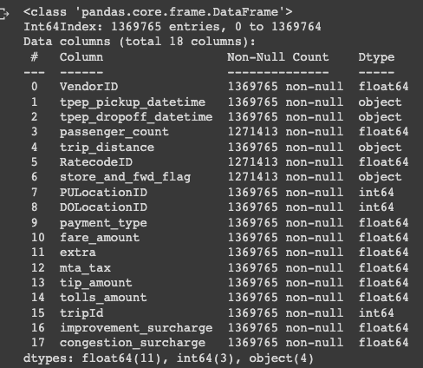
Data Merge
Rows: 1369765
Columns: 18

Slide 8
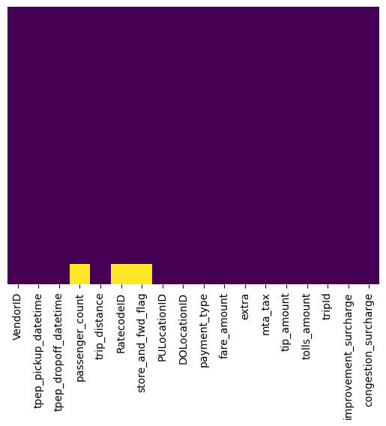
MISSING VALUES CHECK
Above Heatmap shows that passenger_count, RatecodeID, and store_and_fwd_flag got some null values.

Slide 9
FIXING MISSING VALUES
Below there are 2 steps to deal with missing value attributes: Step 1: Drop features with more than 30% of missing data. Step 2: Remove or fill all the null values of a particular attribute/ column with its mean/ mode/ median.
Here, we are selecting Step 2 and removing all the records that contain null (nan) values.

Slide 10
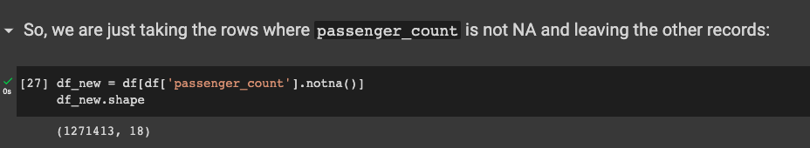
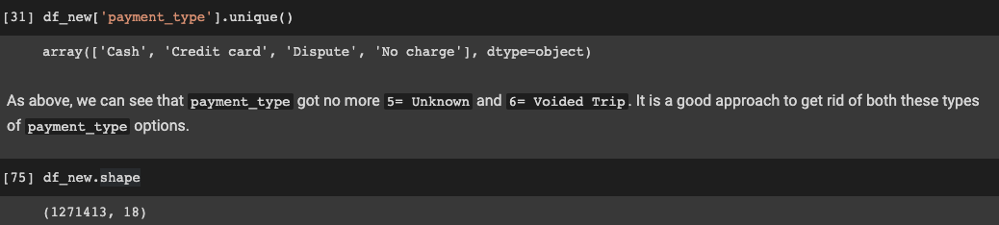
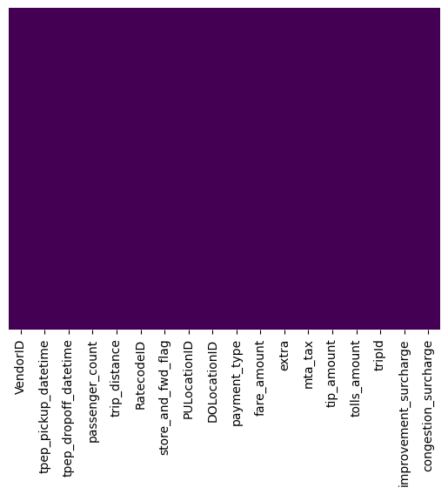
FIXING MISSING VALUES
Hence, no more null values now

Slide 11
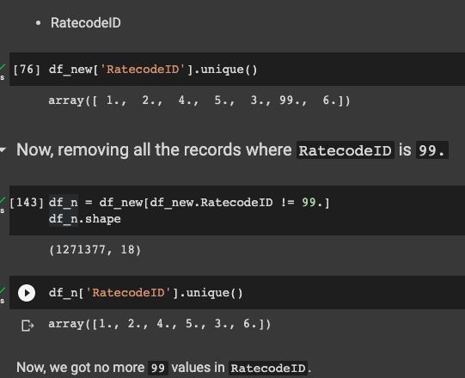
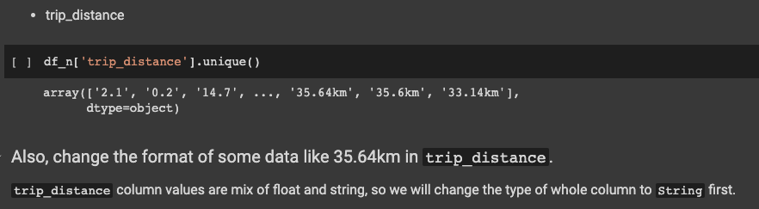
FIXING WRONG FORMATTED VALUES

Slide 12
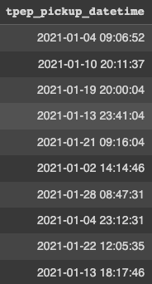
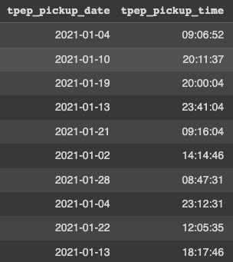
SPLITTING DATETIME COLUMNS

Slide 13
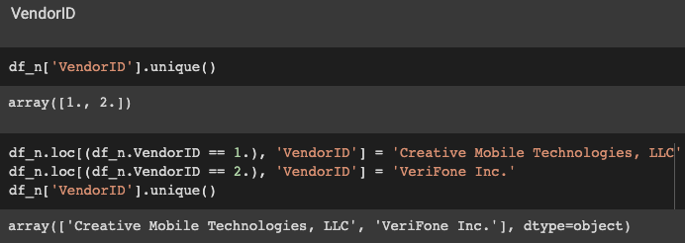
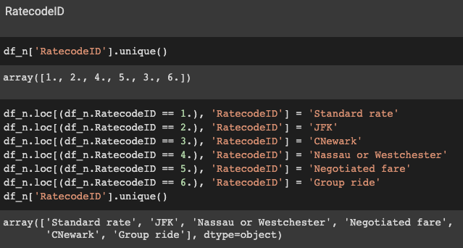
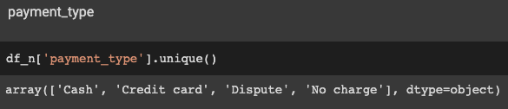
CONVERTING NUMERICAL CATEGORICAL VARIABLES TO STRING

Slide 14
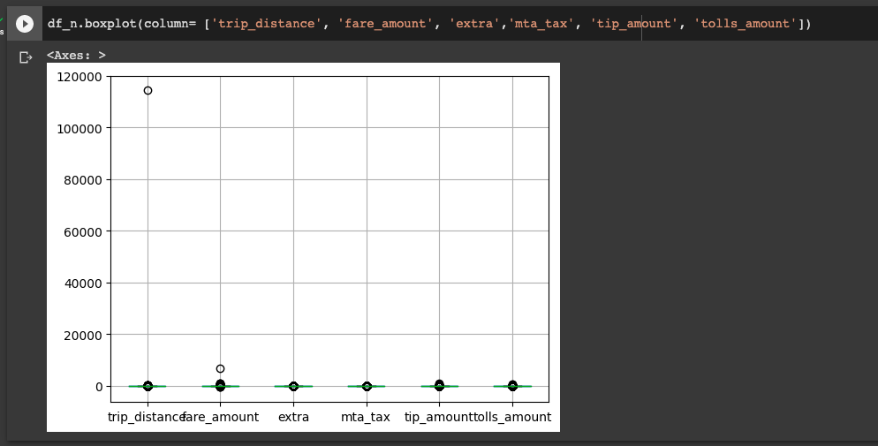
REMOVING ANOMALIES/ OUTLIERS
Here, we will remove just couple of outliers instead of applying the whole code (including
25th and 75th quartile range) because removing significant number of outliers is resulting
in some essential data loss.

Slide 15
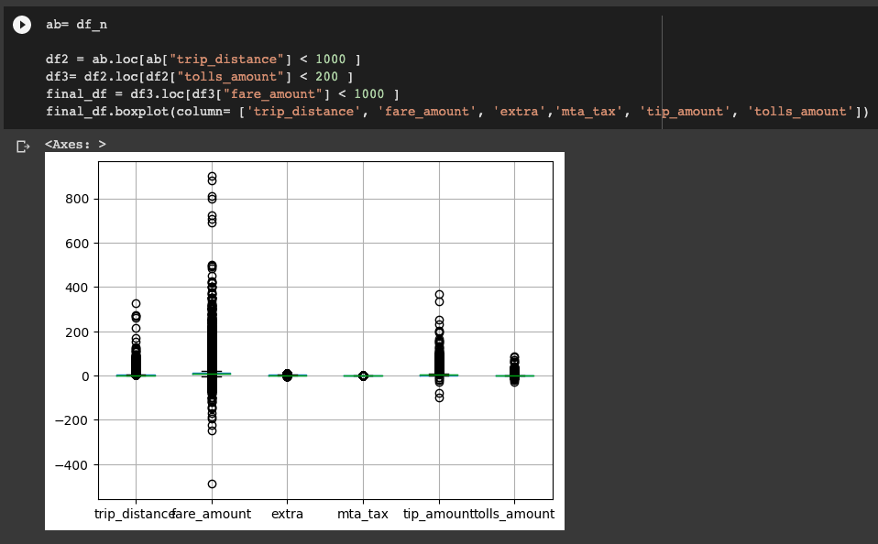
REMOVING ANOMALIES/ OUTLIERS

Slide 16
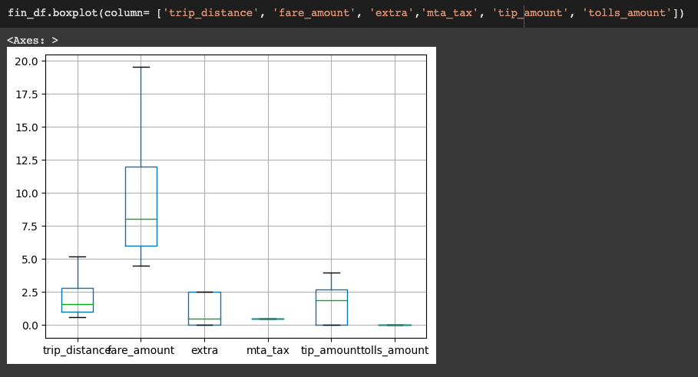
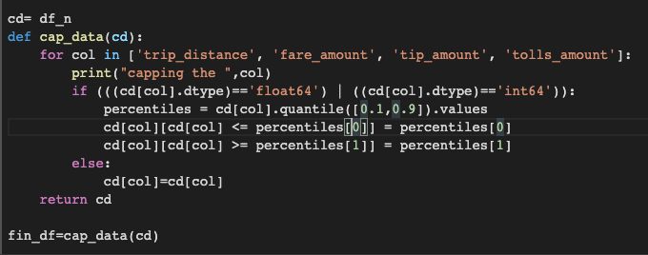
OUTLIERS REMOVAL
However, we can perform the below function to remove the outliers in a specific Quartile Range but this will result in the loss of some essential data records. Therefore, we decided not to use any Quartile Range here.

Slide 17
04.
DATA ANALYSIS
Visually analyzing the data and forming relations as per our defined business problems.

Slide 18
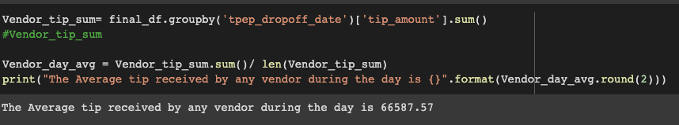
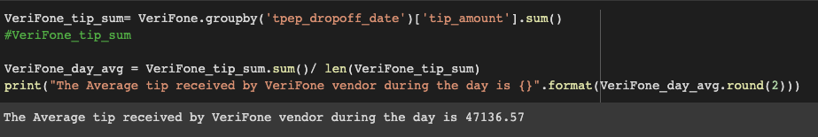
Average tip received by a vendor during the day

Slide 19
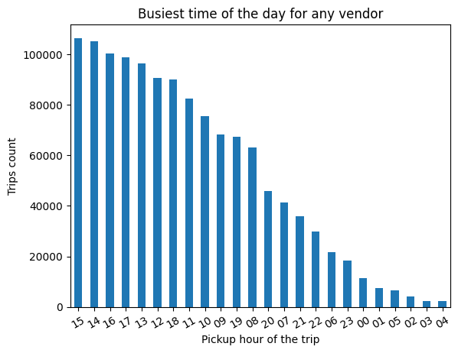
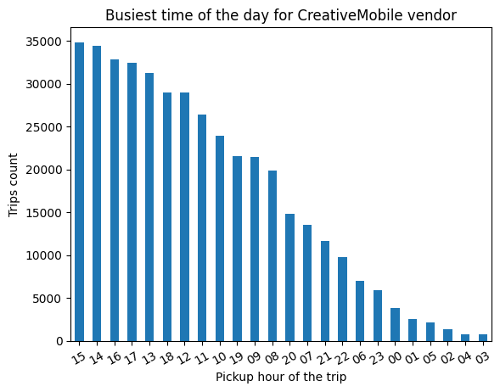
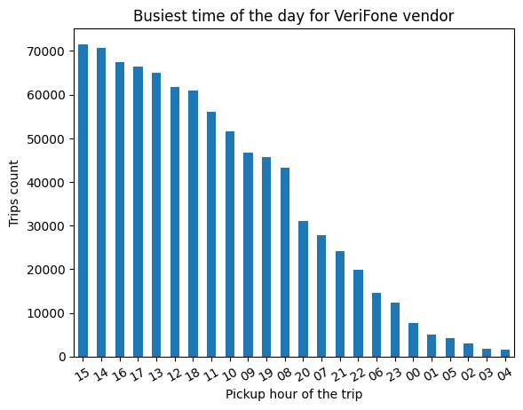
Which time of the day is the busiest
Hence, the busiest time of the day during January, 2021
is 3 pm, 2 pm, & 4 pm.

Slide 20
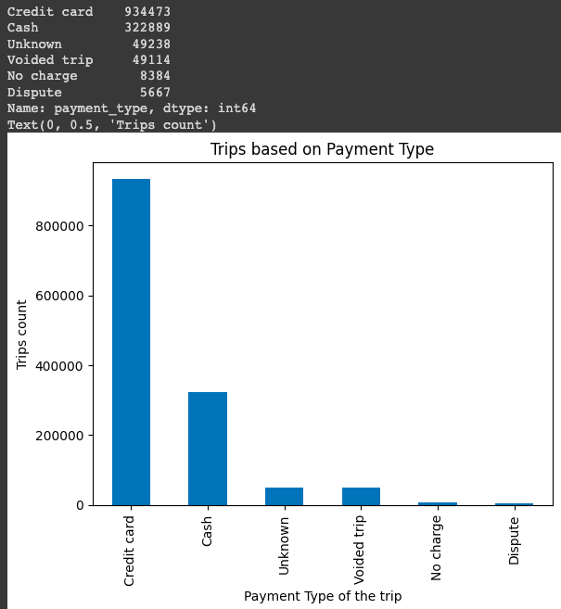
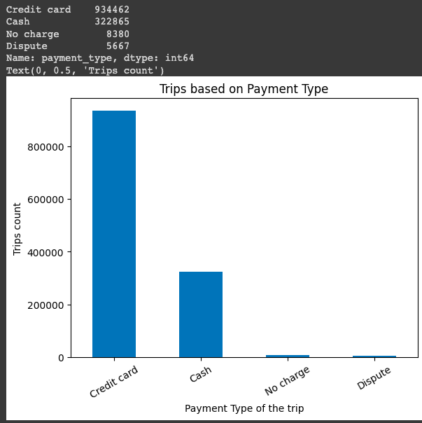
Classify trips based on Payment Type
Before removing nan values
After removing nan values
Majority of the trips’ payment type is Credit Card (934473 or 934462 trips) followed
by Cash (322889 or 322865 trips).

Slide 21
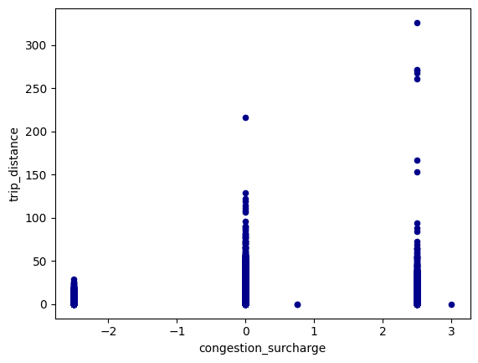
Relationship between congestion surcharge & trip distance
Majority of the trips (trip_distance) have been assigned a congestion_surcharge of 0. and 2.5

Slide 22
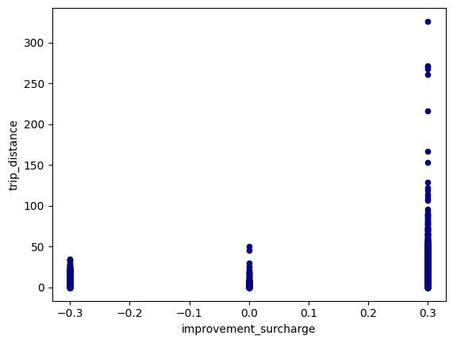
i) Relationship between improvement_surcharge & trip_distance
Miscellaneous Analysis
Hence, majority of the higher trip_distance trips have been assigned a improvement_surcharge of 0.3

Slide 23
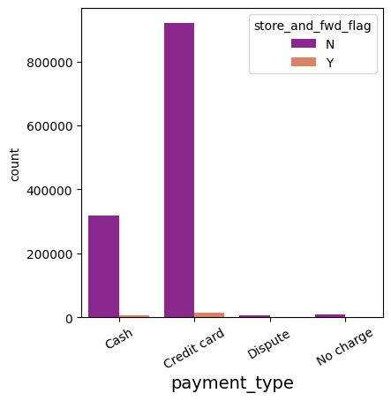
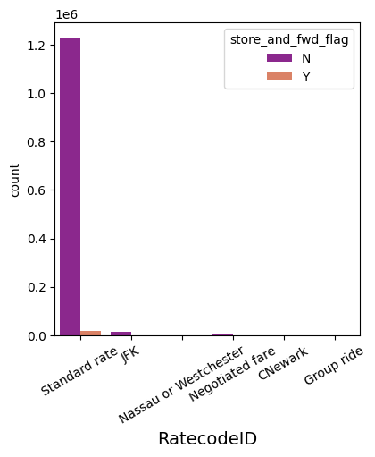
Miscellaneous Analysis
ii) Relation between payment_type vs store_and_fwd_flag and RatecodeID vs store_and_fwd_flag
Hence, almost all the trips were not a “store and forward trip”.

Slide 24
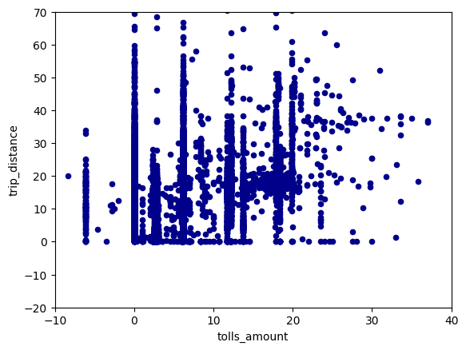
Miscellaneous Analysis
iii) Relation between tolls_amount and trip_distance
Hence, we can see a positive linear correlation between tolls_amount and trip_distance .

Slide 25
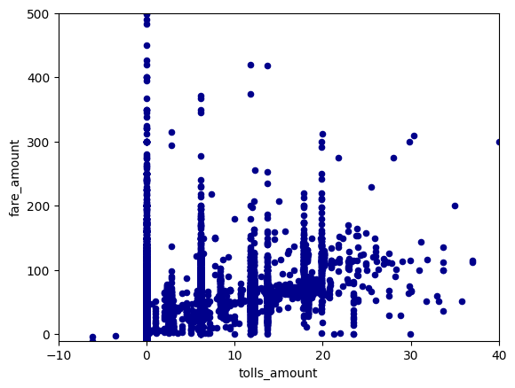
Miscellaneous Analysis
iv) Relation between tolls_amount and fare_amount
Hence, we can see a positive linear correlation between tolls_amount and fare_amount .

Slide 26
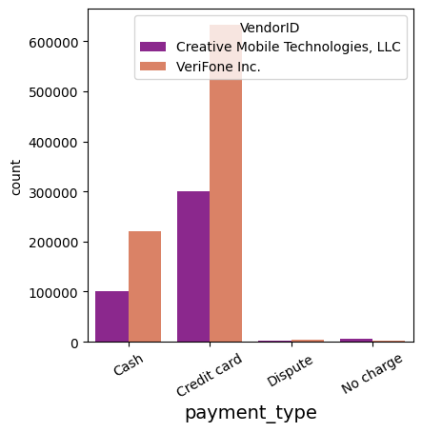
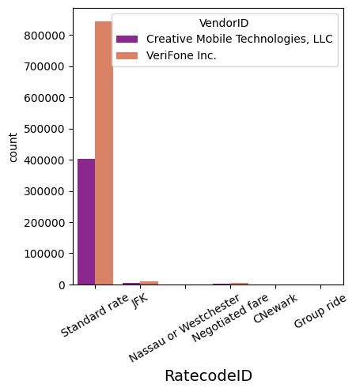
Miscellaneous Analysis
v) Relation between payment_type vs VendorID and RatecodeID vs VendorID
Hence, we can see VeriFone Inc. VendorID got almost double trips than Creative Mobile Technologies VendorID

Slide 27
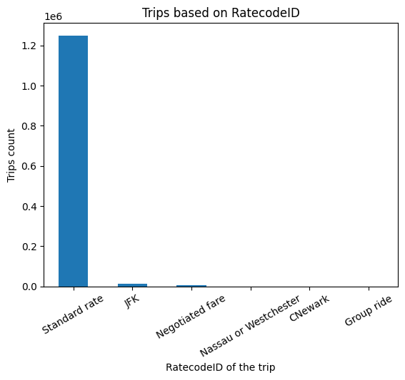
Miscellaneous Analysis
vi) RatecodeID
Hence, we can see almost all trips got Standard rate as the RatecodeID.

Slide 28
THANKS
Do you have any questions?
rohitmanral777@gmail.com
0434038738

